Slide 1
MSDS670_X40_Data Visualization Regis University
Week 7 Assignment
Ilse Severance

Slide 2
Overview
During this analysis, we aim to understand how Valentine’s spending behavior in India has shifted year-over-year and whether the differences observed between last year and this year indicate a broader market trend or segment changes. By investigating spending variation alongside relationship status, gender, city, gifting preferences, and plans, this study seeks to identify patterns that explain consumer decision making.

Slide 3
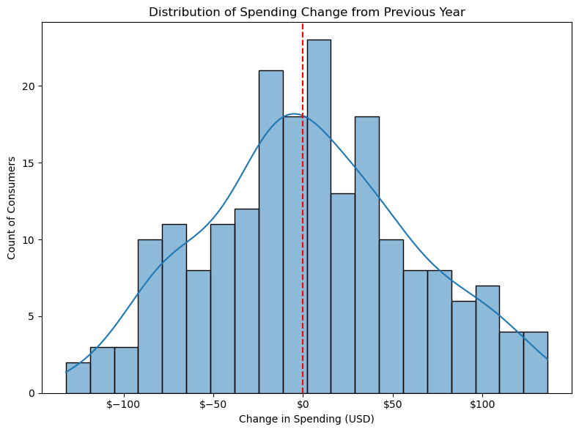
Valentine’s Spending Trends: Last Year vs This Year Consumer Analysis
Year over year spending change remains centered around Last Year’s levels, with the overall change clustering closely around zero.
High individual variability is clear, with some consumers increasing or decreasing spending by over $100, indicating diverse financial or emotional responses.
No extreme overall shift is visible, suggesting that changes in Valentine’s spending are driven by specific segments than by broad market trend.

Slide 4
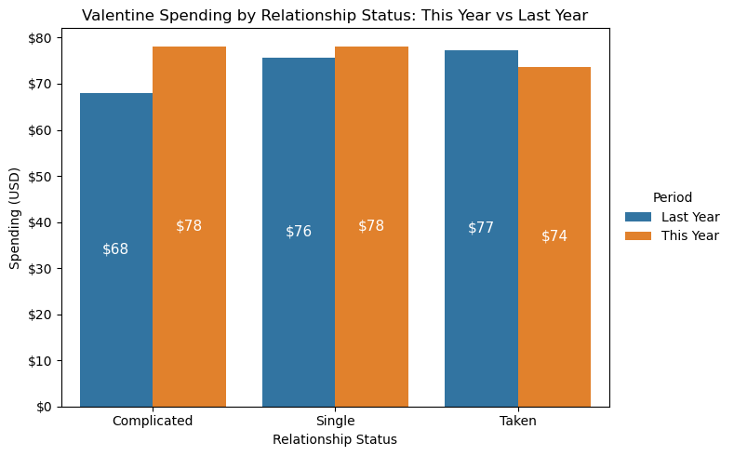
Valentine’s Spending by Relationship Status: This Year vs Last Year Comparison
Spending among “Singles” showed a slight increase from $76 to $78, indicating steady spending.
The “Complicated” relationship show a notable increase in spending, rising from $68 to $78, suggesting a significant shift toward higher Valentine’s spending.
Spending among those “Taken” decreased slightly from $77 last year to $74 this year, which could reflect changing priorities within committed relationships.

Slide 5
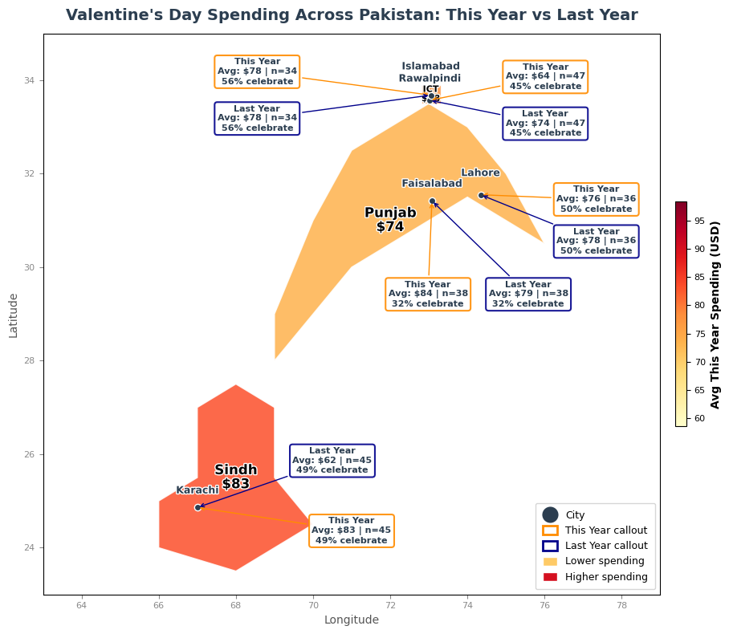
Valentine’s Spending by City: This Year vs Last Year Comparison
Spending increased in Faisalabad and Karachi, with Karachi showing the largest jump from $62 to $83.
Lahore and Islamabad maintained a stable spending year-over-year.
Rawalpindi experienced a decrease in spending from $74 to $64, suggesting possible shifts in consumer behavior or economic factors.

Slide 6
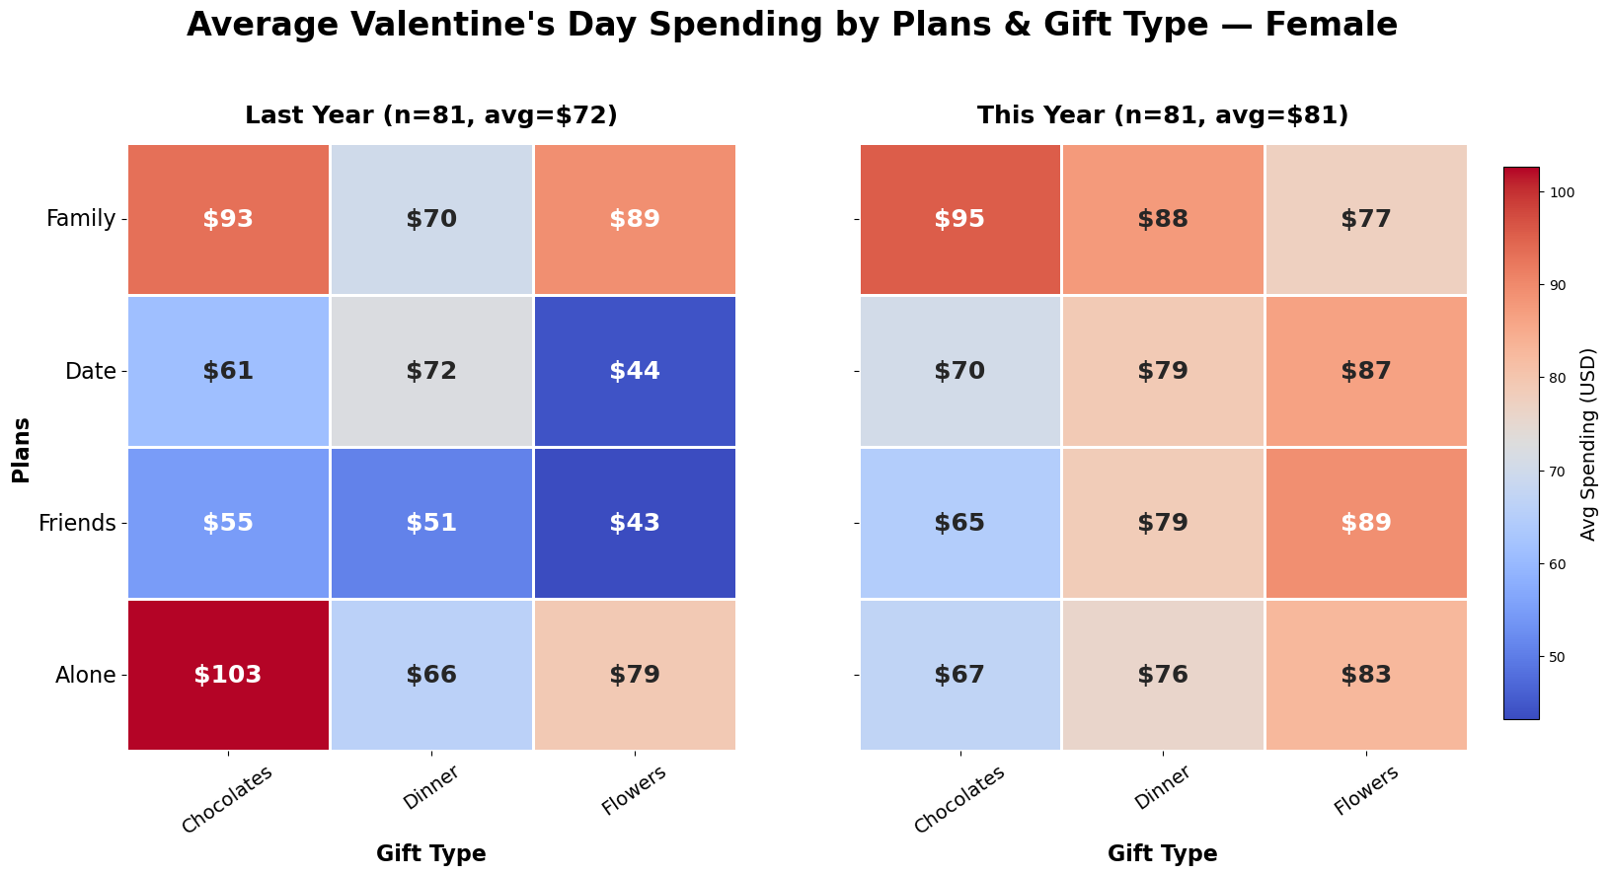
Female Valentine’s Spending: Last Year vs This Year Comparison
Average spending increased from $72 to $81 year-over-year, indicating slightly higher willingness to spend.
Significant growth in spending on “Date” and “Friends”, especially on gifts like Flowers and Dinner suggesting an interest in experiential and group celebrations.
Spending “Alone” plans decreased, especially on Chocolates, suggesting a reduction in individual purchases.

Slide 7
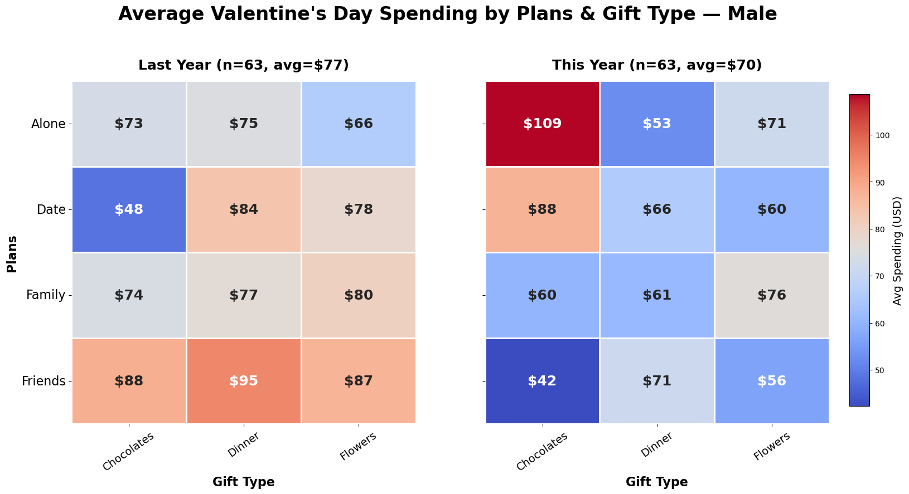
Male Valentine’s Spending: Last Year vs This Year Comparison
Average spending decreased from $77 to $70 year-over-year, indicating a potential shift in male consumer behavior.
Notable increase in spending by males celebrating “Alone” with Chocolates.
A strong decrease in “Friends” and “Family” spending suggests a change in gift preferences for social interaction.

Slide 8
Conclusions
The analysis of Valentine’s spending reveals both overall market trends and segment shifts in consumer behavior in India. Spending patterns vary by relationship status, gender, gifting preferences, and city, with populations from Karachi, Rawalpindi, Lahore, Islamabad, and Faisalabad showing distinct regional differences. While some segments demonstrate spending stability, others exhibit unpredictability driven by changing preferences and plans. These insights highlight evolving consumer dynamics and can guide businesses in tailoring marketing strategies, product offerings, and promotions to better engage customer groups.

